Slide 1
Multiple populations in globular clusters: a clue to second parameter problem?
R. Gratton
INAF-Osservatorio Astronomico di Padova, Italy

Slide 2
Collaborators for this project
Eugenio Carretta
Angela Bragaglia
Sara Lucatello
Antonio Sollima
Yazan Al Momany
Santi Cassisi
Valentina D’Orazi

Slide 3
First parameter: metallicity
Sandage & Wallerstein 1960; Faulkner 1966
Graphs from Lee et al. 1994
However: second parameter needed (Sandage & Wildey 1967; van den Bergh 1967)

Slide 4
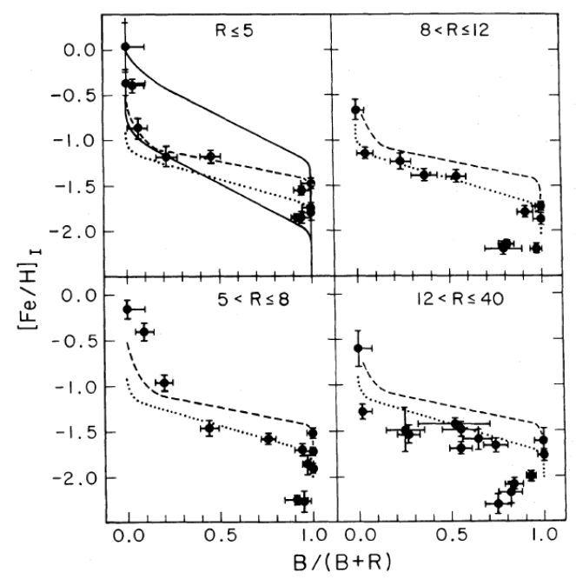
Zinn, 1980, ApJ, 241, 602
The second parameter is correlated with galactocentric distance

Slide 5
Age: Lee et al. 1994

Slide 6
Dotter et al. 2010, ApJ, 708, 698
ACS data - Ages from MS fitting

Slide 7
Additional parameter required
Several GCs have very extended HBs. Cannot be explained by metallicity/age differences
Distribution of stars along the HB is determined by their mass and chemical composition ➔ He-abundance (He-stars evolve faster on the MS; current He-rich HB stars should be less massive: Freeman & Norris, 1981)
➔ linked to O-Na anticorrelation (redder stars should be O-rich/Na-poor; bluer stars should be O-poor/Na-rich: D’Antona & Caloi 2004)
However, other effects may be important: rotation and/or random mass loss (see e.g. Catelan 2009)

Slide 8
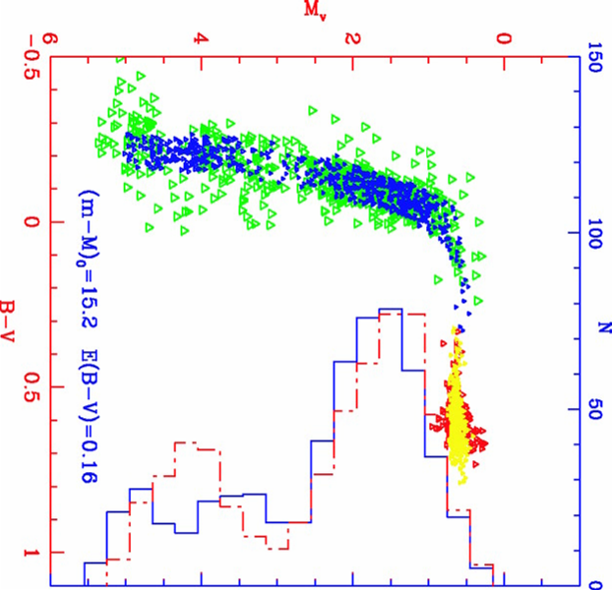
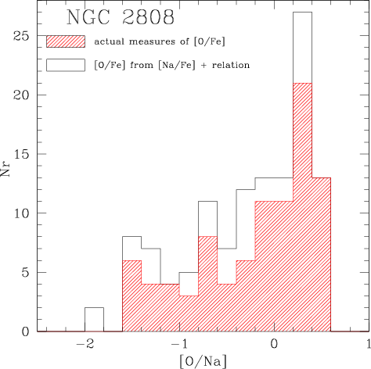
Na-O anticorrelation ➔ He ➔ HB
D’Antona et al. 2005
NGC2808

Slide 9
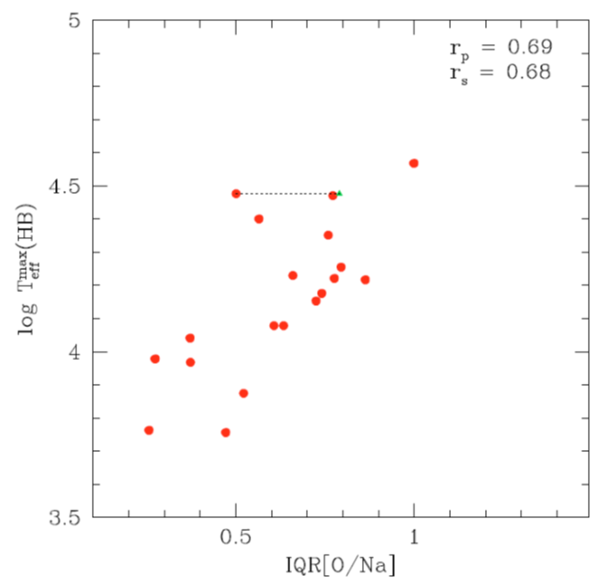
HB extension and Na-O anticorrelation
Recio-Blanco et al. 2006
Carretta et al. 2010

Slide 10
The impact of abundance variations on the HB (Gratton et al. 2010)
Reanalysis of photometric databases:
HST snapshot (Piotto et al. 2002)
Ground Based (Rosenberg et al. 1999a, 1999b)
Ages from MS fitting

Slide 11
Minimum (5%)
Median
Maximum (95%)
of the distributions of stars along the HB
Red: old GCs
Blue: young GCs
White: no Age

Slide 12
(B-V)_{med} is closely related to HBR

Slide 13
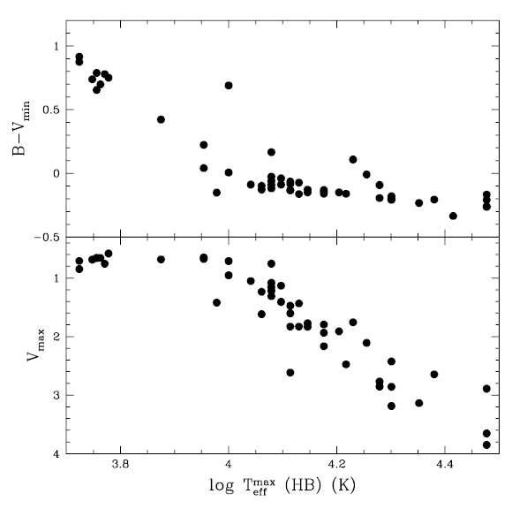
B-V_{min} is closely related to log T_{eff}(max)

Slide 14
Transformation into masses
Simple, although not linear dependences of median masses on [Fe/H]
More scatter for minimum masses
Red: old GCs
Blue: young GCs
White: no Age

Slide 15
Mass loss law
Mass lost along the RGB can be obtained by comparing median HB masses with masses at tip of RGB (using age and chemical composition)
Quite small scatter!
Red: old GCs
Blue: young GCs
White: no Age

Slide 16
However, there should be a third parameter
NGC6934 and NGC1904 has the same [Fe/H] and Age, but very different HB’s

Slide 17
Ages from HB
Assuming a universal mass loss law, ages can be derived from M_{med}, summing up the mass lost and considering the chemical composition.
This ages have very small internal errors.

Slide 18
Ages from HB and from MS
These ages correlate with those from MS (better for large and small GCs, worst for GCs of intermediate mass).
However the scatter is much larger than internal errors.

Slide 19
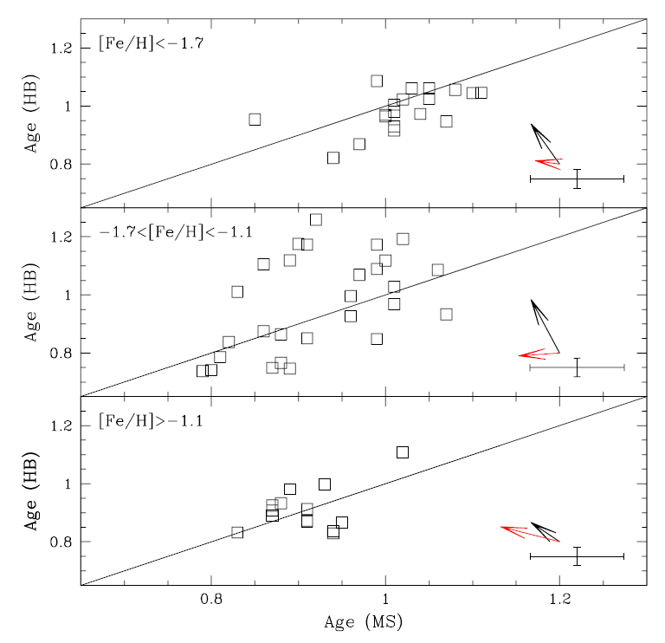
Effect of variations of He and metal abundances
Ages from HB’s are very sensitive on variations on He (black arrows, ΔY=0.02). Mainly so GCs of intermediate metallicity.
The dependence has a different sign to that for MS stars
Ages from MS and HB can be put in agreement with suitable He

Slide 20
Spread of colours along the HB
The case of NGC4833 cannot be reproduced by a Gaussian distribution of masses!

Slide 21
The spread in masses along the HB is strongly correlated with M_{v}
47 Tuc
47 Tuc
M3

Slide 22
Y_{max} is correlated with M_{v}
47 Tuc
47 Tuc
M3

Slide 23
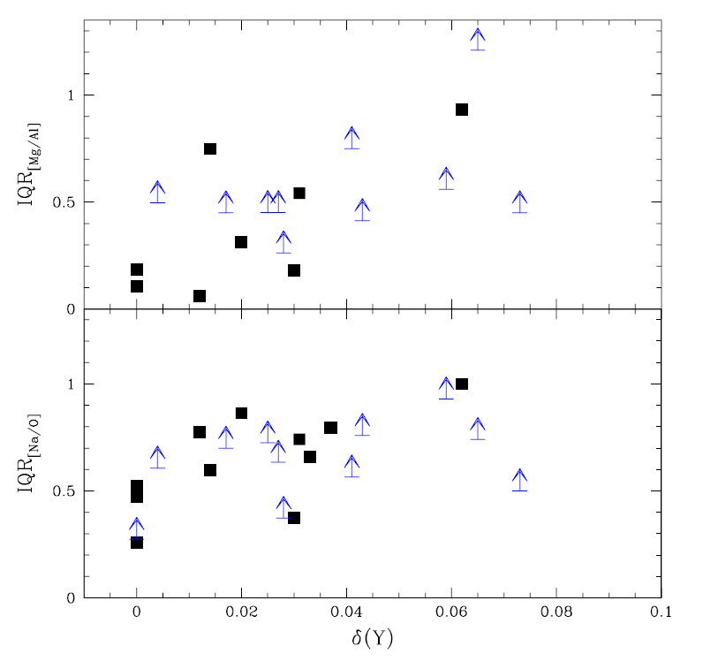
Correlation with chemistry
Small statistics;
Large errors
No Offset (Al production and Mg destruction is simply proportional to Y production)
Offset (no Y variation for moderate production of Na/destruction of O)
Better statistics;
smaller errors

Slide 24
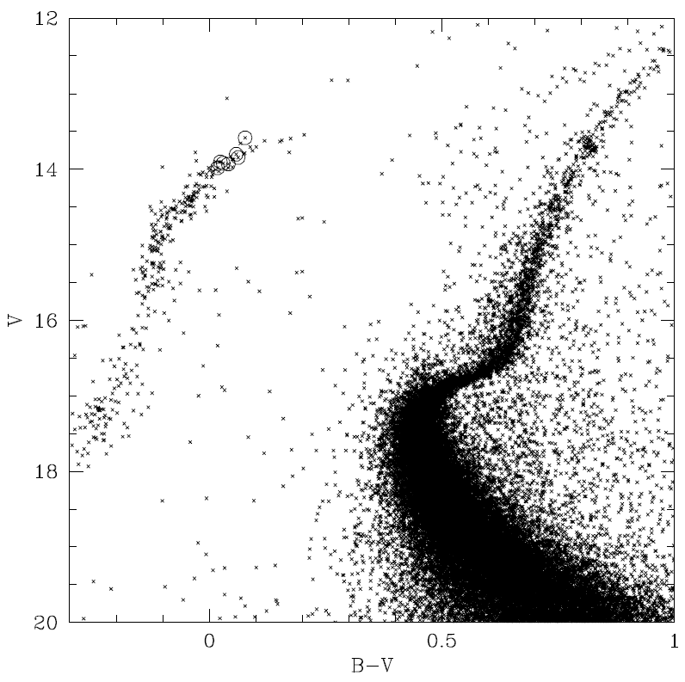
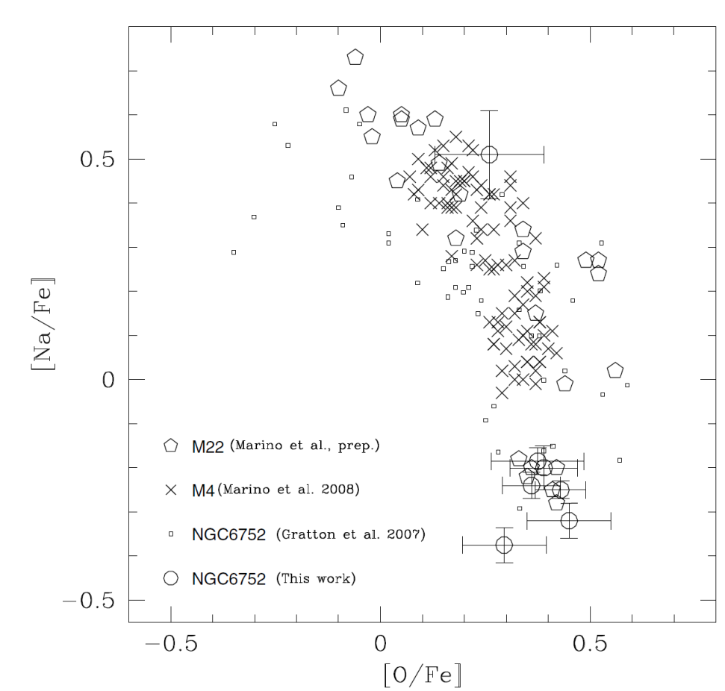
Villanova et al. 2009: NGC6752
Grundahl jump
evolved
Diff+Rad lev.

Slide 25
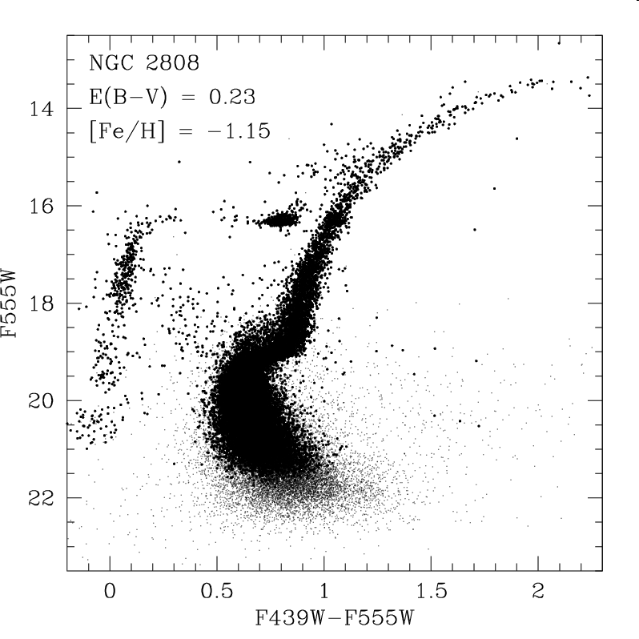
Prediction for NGC2808
Moderately O-rich
Na-rich, Y~0.28
O-rich
Na-poor
Diff+Rad lev.

Slide 26
M4
(Marino et al. 2011, ApJL, 730, L16)

Slide 27
M22 (Marino et al. 2013, ApJ 768, 27)
Grundahl jump

Slide 28
Our program
FLAMES/Giraffe observations of ~100 HB stars in seven globular clusters:
  NGC2808 – Trimodal HB and triple MS
  NGC1851 – Bimodal HB and double SGB
  47 Tuc – Red HB with some evidence for double MS
  M5 – Extended HB; not yet evidence for splitting in other sequences
  M22 – BHB and double SGB
  NGC6723 - Extended, possibly multimodal HB (dominated by BHB)
  NGC6388 - Extended, possibly multimodal HB (dominated by RHB)

Slide 29
Observations
Stars observed
  RHB and BHB with T_{eff}<11500 K (Grundahl jump)
Stars not observed
  RR Lyrae variables: MOS observations in Service Mode yield random phases
  BHB stars with T_{eff}>11500 K (sedimentation and radiation levitation prevents use for present purposes)
Two spectral regions:
  HR12: NaI D + HeI 5876 (+FeI, FeII, Si, Ca, Mn, Ni, Ba)
  HR19: OI triplet + NaI 8183-94 (+FeI, NI, CN, MgI, MgII, AlI, SiI)

Slide 30
NGC2808
(Gratton et al. 2011, A&A, 534, 123)
Grundahl jump

Slide 31
NGC1851
(Gratton et al. 2012, A&A, 539, 19)
Grundahl jump

Slide 32
47 Tucanae
(Gratton et al. 2013, A&A, 549, 41)

Slide 33
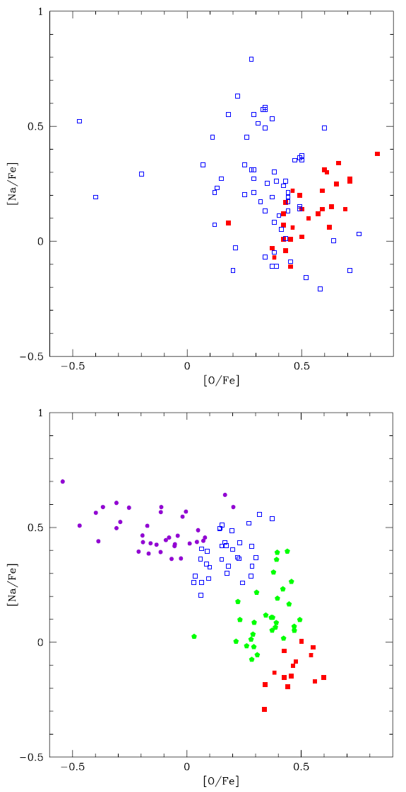
M5 (Gratton et al. 2013, A&A, 549, 41)
Grundahl jump

Slide 34
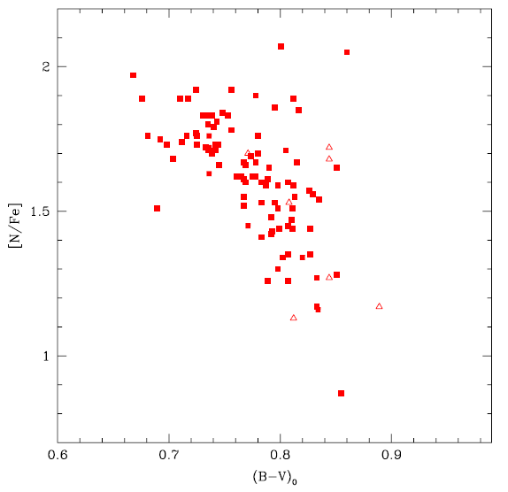
N abundance variations
47 Tuc
M5

Slide 35
M22 (Gratton et al. 2013 in preparation)

Slide 36
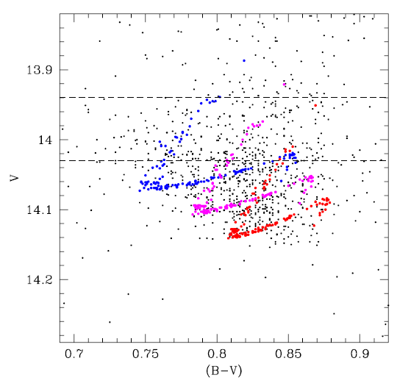
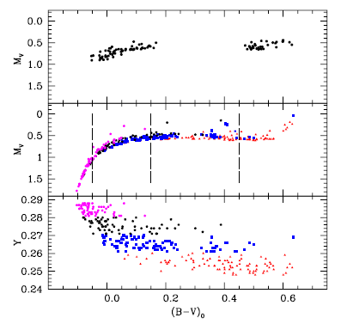
Comparison with synthetic HB’s
47 Tuc (ΔHe<0.03)
M5 (ΔHe + ΔM=0.03 Mo)

Slide 37
Rotation along the HB
If core of the stars rotates faster, it can grow to larger masses before the flash
➔ more mass loss along the RGB
➔ smaller mass of HB stars
➔ bluer HB stars
Peterson and co-workers (1983-1985): a few stars in each GC (M3, M4, M5, NGC288), with encouraging indications

Slide 38
Rotation along the HB
Behr et al. (1999-2001) and Recio-Blanco et al. (2002, 2004): only a fraction of the stars cooler than the Grundahl-jump have high rotational velocity (>15 km/s)

Slide 39
Rotation along the HB
Scatter of rotation velocities along the HB
Fraction of fast rotators among BHB stars

